Slide 1
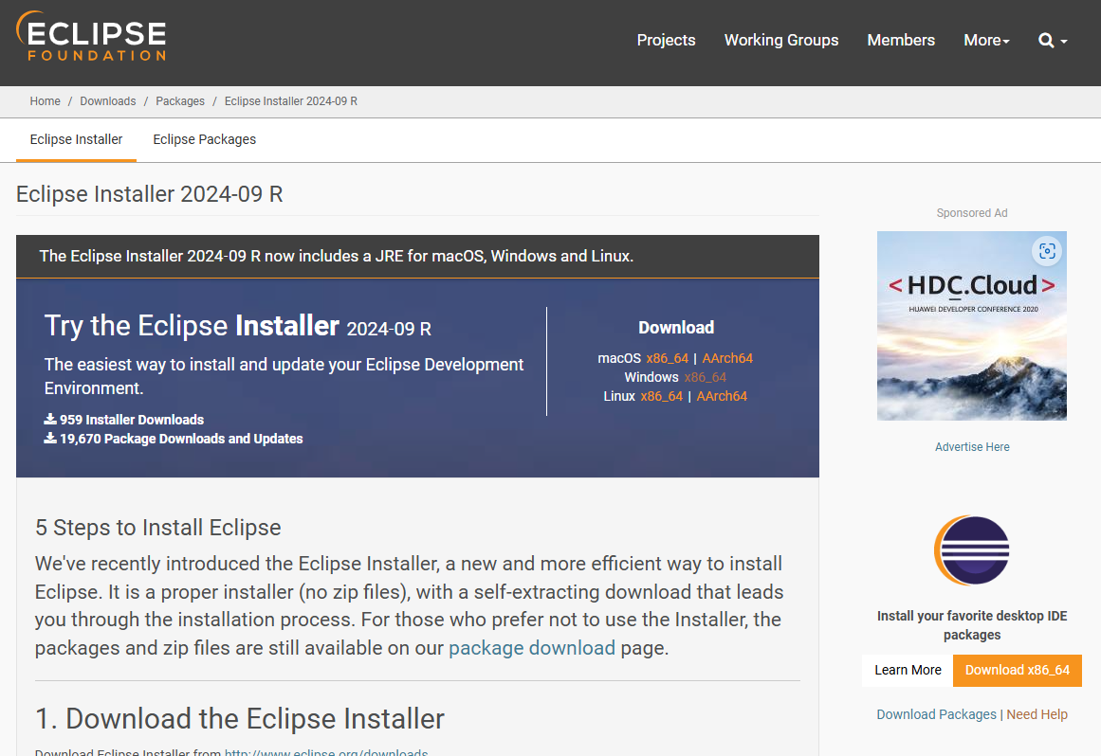
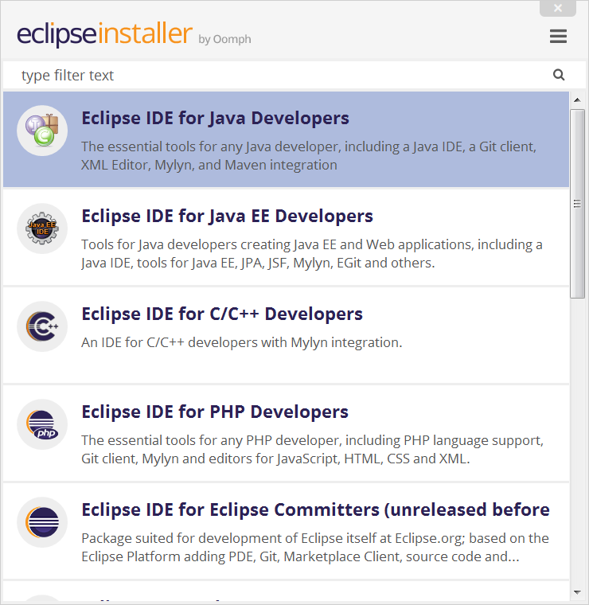
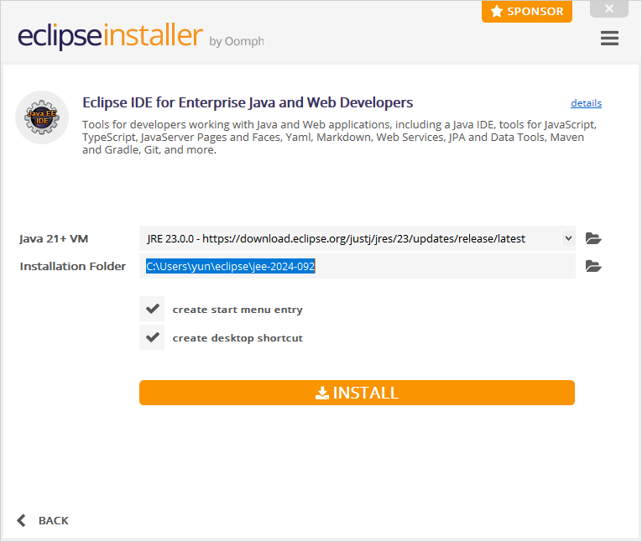
Appendix _Window How to Install Eclipse
1. Eclipse Download
https://www.eclipse.org/downloads/packages/installer
Select version what your device support.
[Windows x86_64]
2. Select Eclipse IDE for Java EE Devloper
Select Eclipse IDE for Java EE Devloper on install menu after click eclipse-inst-jre-win64 which you download
Click Install

Slide 2
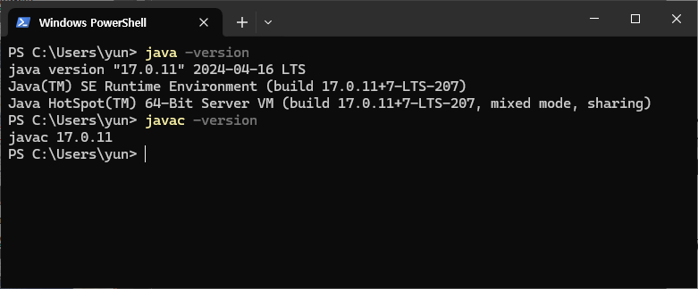
Appendix _Window How to Install Eclipse
3. Check Eclipse and Java Installed well
java -version
javac -version
4. But If you are not unavailble to find Java and Eclipse by thise way. Do following slides.

Slide 3
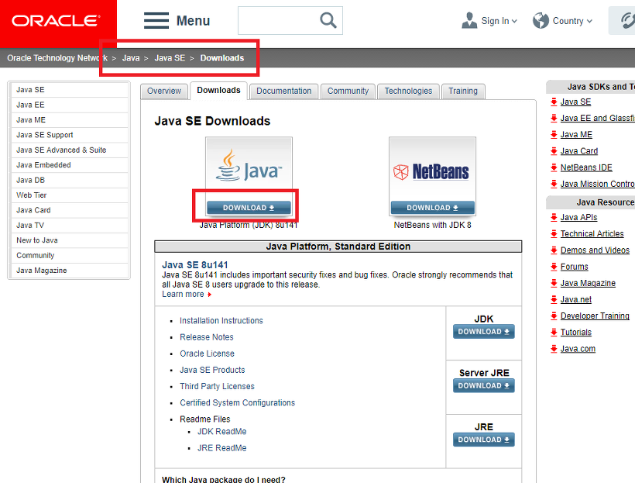
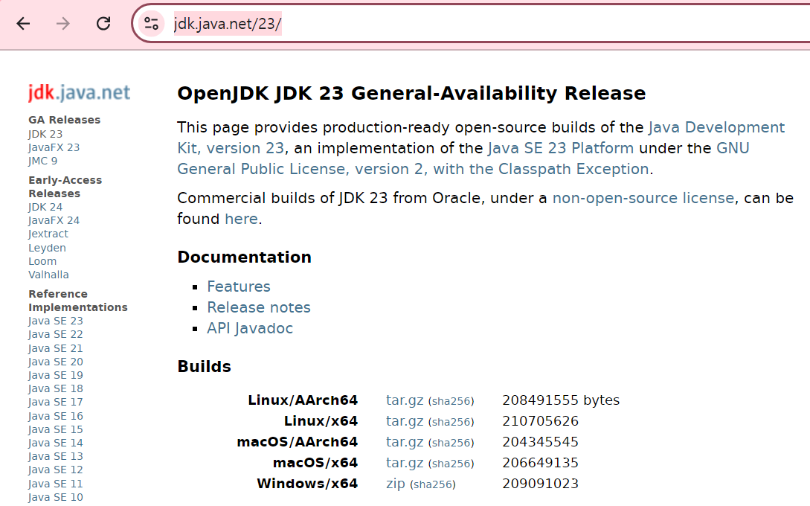
Appendix _Window Java Install
1. JDK Install
[JAVA JDK Download]
https://www.oracle.com/java/technologies/downloads/?er=221886
or
[OpenJDK Download]
https://jdk.java.net/23/

Slide 4
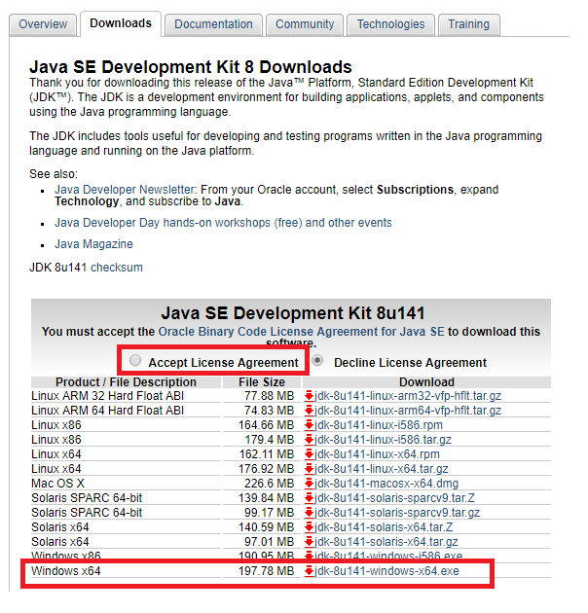
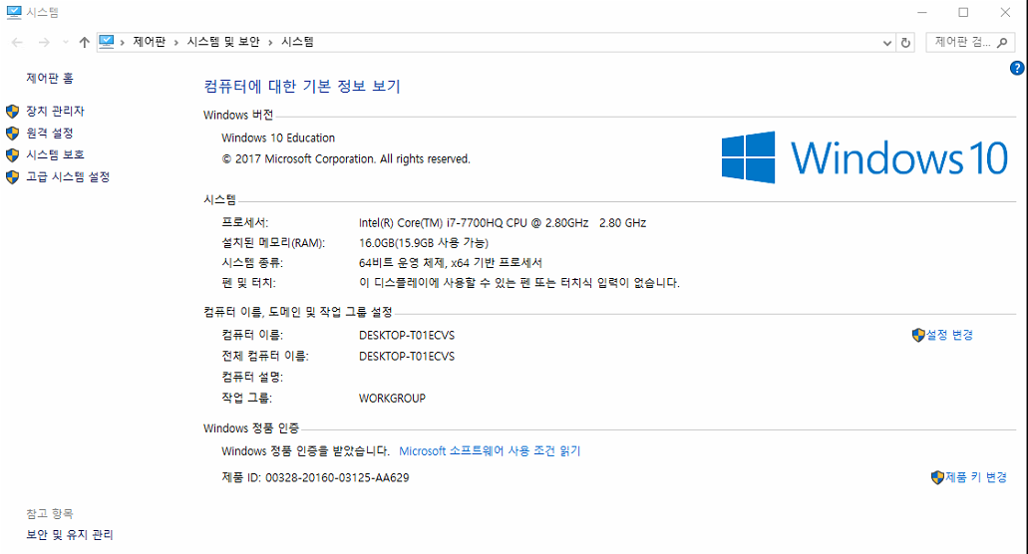
Appendix _Window Java Install
JDK Install
You can install it according to your OS environment. How to check my computer or My PC -> Right click on the mouse properties and check the system part

Slide 5
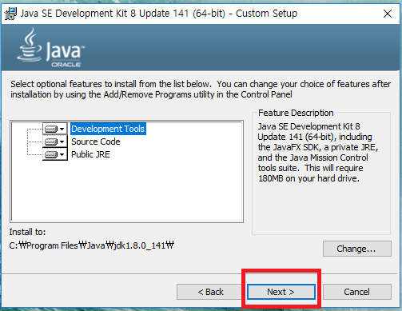
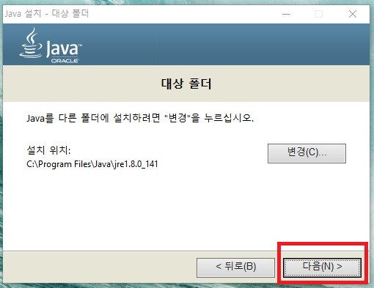
Appendix _Window Java Install
JDK Install
Next Button

Slide 6
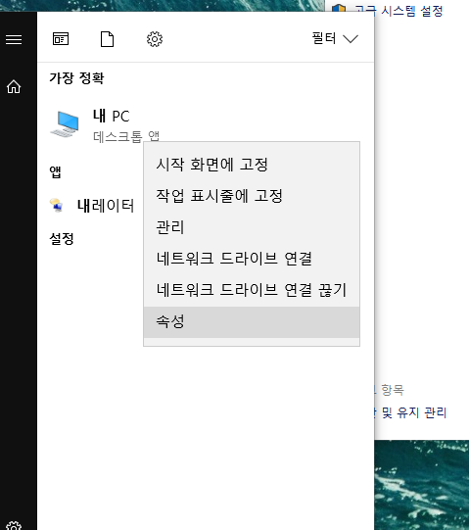
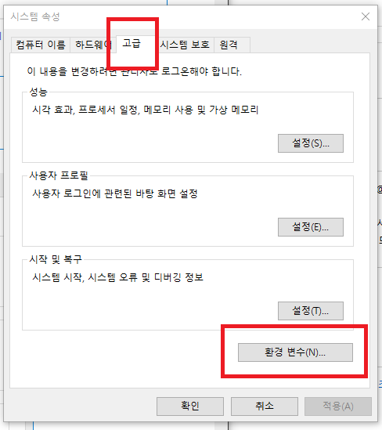
Appendix _Window Java Install
JDK Install _ Environment Variables
If you do not specify a path specifically, Java jdk and jre will be installed in C: \ Program Files \ Java path.
Now let's get the environment variables. (If your Computer is Window 10, don’t have to point environment variables.

Slide 7
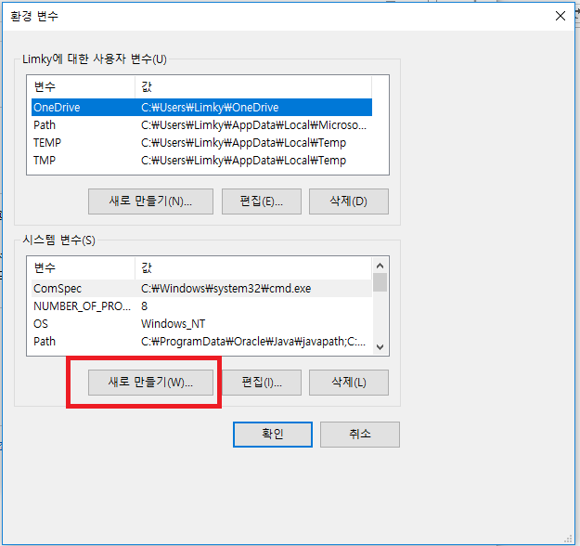
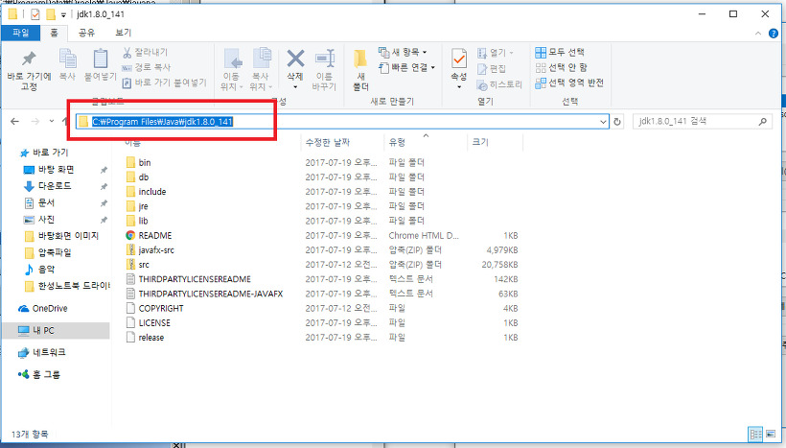
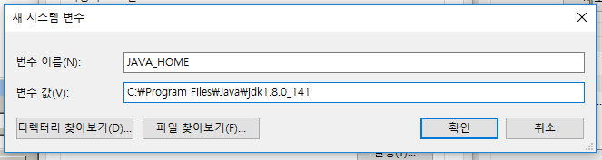
Appendix _Window Java Install
JDK Install _ Environment Variables
Java Path Copy and Paste environment variables.

Slide 8
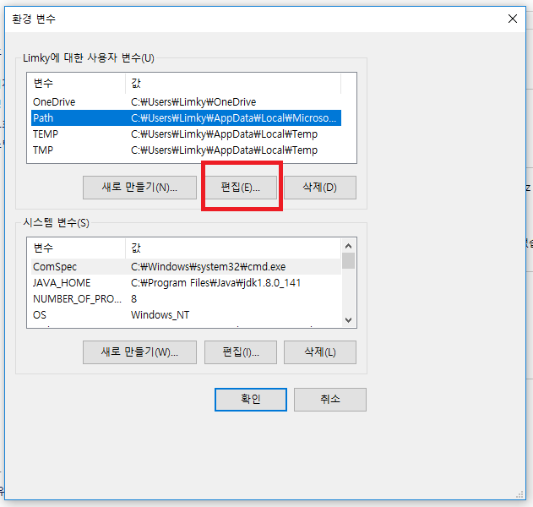
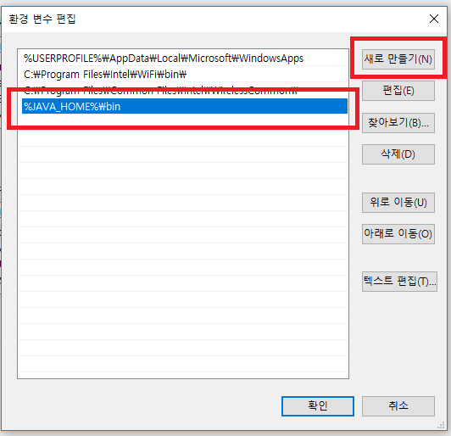
Appendix _Window Java Install
JDK Install _ Environment Variables
Edit Button Click and Add New %JAVA_HOME%bin

Slide 9
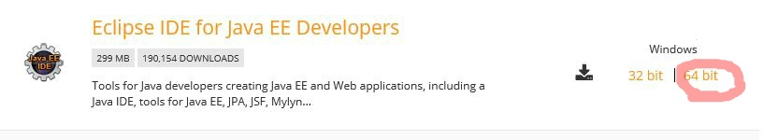
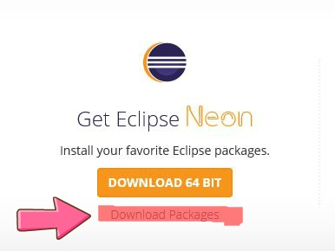
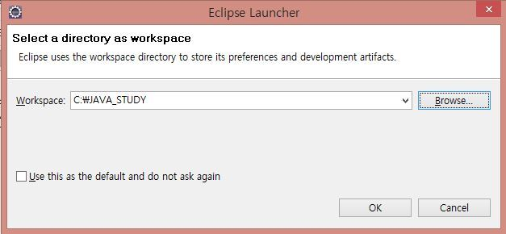
Appendix _Window Java Install
2. Eclipse Install
Now that you have installed Java, you should download the eclipse editor which will use java.
http://www.eclipse.org/downloads/

Slide 10
Appendix _Linux Java Install
1. JDK Install – A
How to install JDK at one time using terminal
Install Oracle Java in terminal
sudo apt-get install software-properties-common -y && \ sudo add-apt-repository ppa:webupd8team/java -y && \ sudo apt-get update && \ echo "oracle-java8-installer shared/accepted-oracle-license-v1-1 select true" | sudo debconf-set-selections && \ sudo apt-get install oracle-java8-installer oracle-java8-set-default -y
Note:
If this is not the run , use Method B.

Slide 11
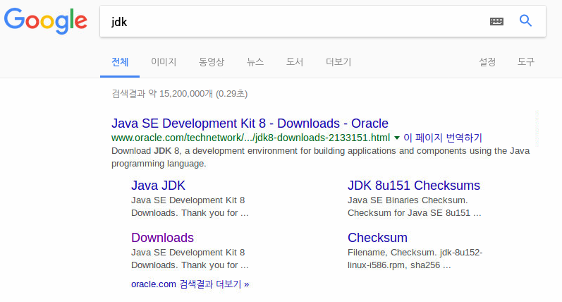
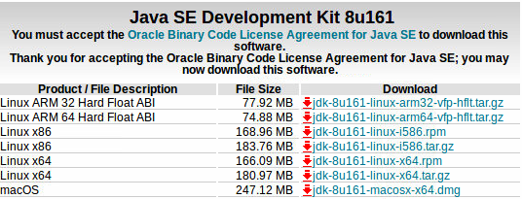
Appendix _Linux Java Install
1. JDK Install – B (1/3)
JDK installation progress
Download the JDK for your OS.
Note: JDK version 8, the number after u does not matter

Slide 12
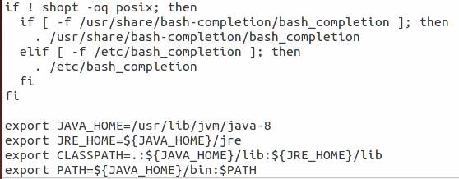
Appendix _Linux Java Install
1. JDK Install – B (2/3)
Environment variable registration process after downloading JDK
Install Oracle Java 1.8
$ sudo mkdir -p /usr/lib/jvm $ sudo mv jdk-8u161-linux-x64.tar.gz /usr/lib/jvm $ cd /usr/lib/jvm $ sudo tar xzvf jdk-8u161-linux-x64.tar.gz $ sudo ln -s jdk1.8.0_11 java-8 $ gedit ~/.bashrc

Slide 13
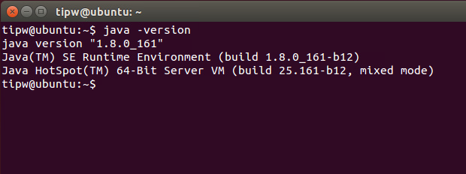
Appendix _Linux Java Install
1. JDK Install – B (3/3)
If environment variable registration is completed, proceed to the next step.
source ~/.bashrc java -version
You can check whether the setting is completed by using java -version.

Slide 14
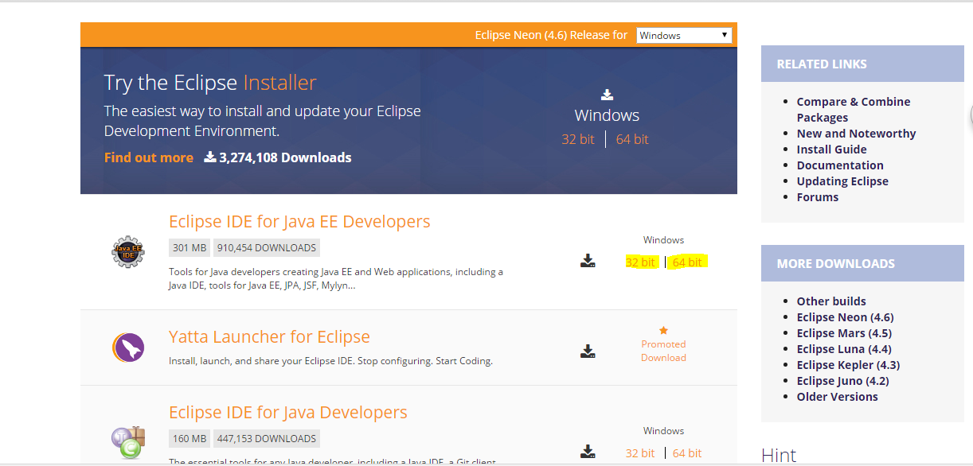
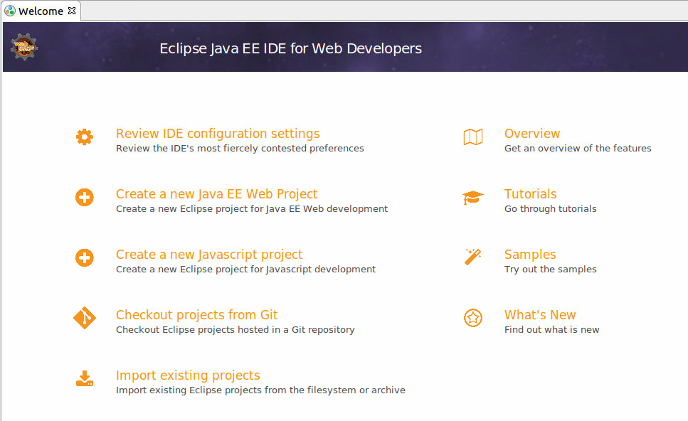
Appendix _Linux
Java Install
2. Eclipse Install
Install git and git-core
$ sudo apt-get install git $ sudo apt-get install git-core
1. Install Git
Download Eclipse IDE for Java EE developer
https://eclipse.org/downloads/eclipse-packages/
2. Run downloaded program
run

